Slide 1



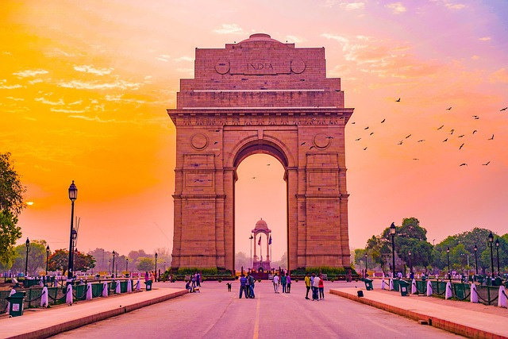
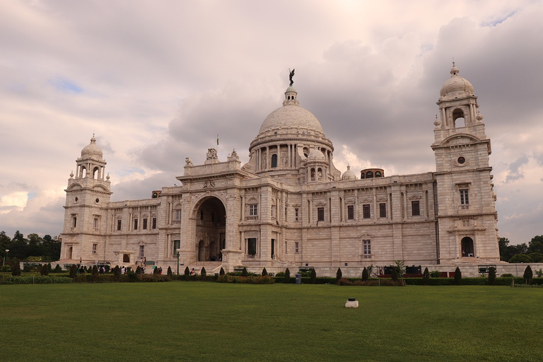
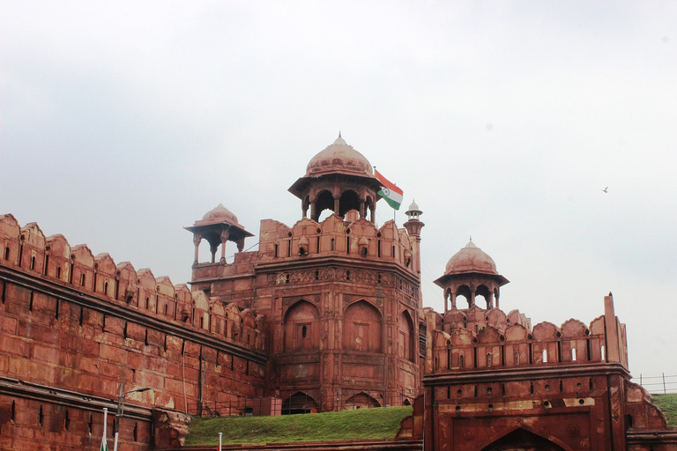
TRAVEL ITINERARY PLANNER

Slide 2
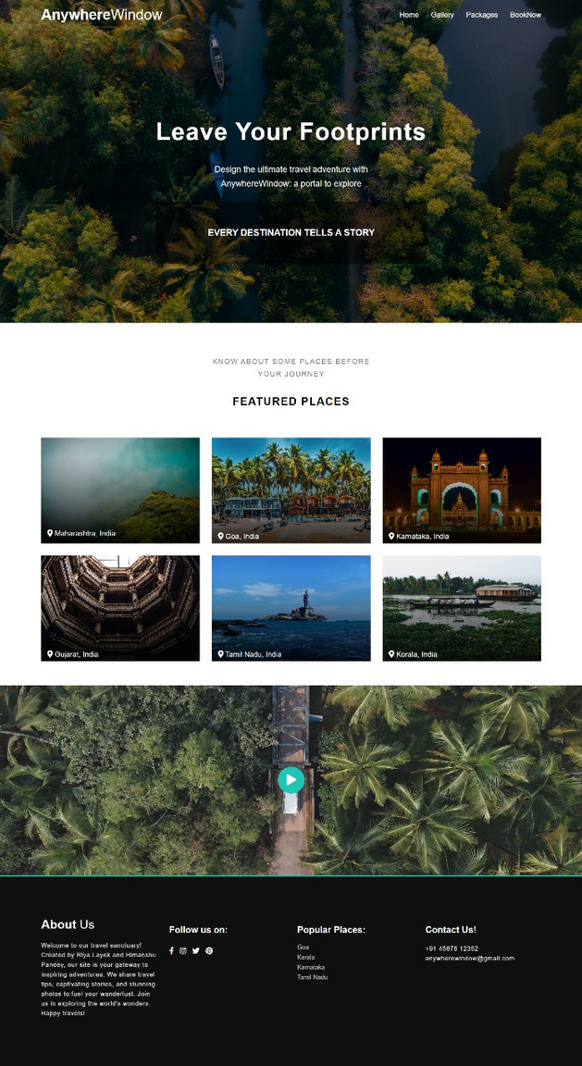

Objective
Users can easily book packages through this user-friendly platform of their desired location.

Slide 3

Technical Details
Technical Details
The front end website is made using HTML CSS and JavaScript
This website is made flexible and responsive.
The Backend of this website is made using php and MySQL database through XAMPP server
The website runs on Xampp Apache server

Slide 4
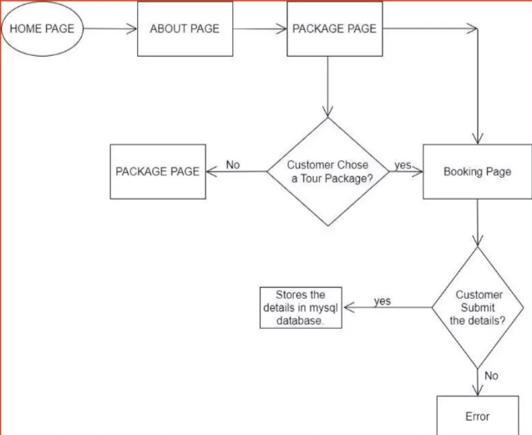
Page of the website
Home Page
Gallery
Package
Booking

Slide 5
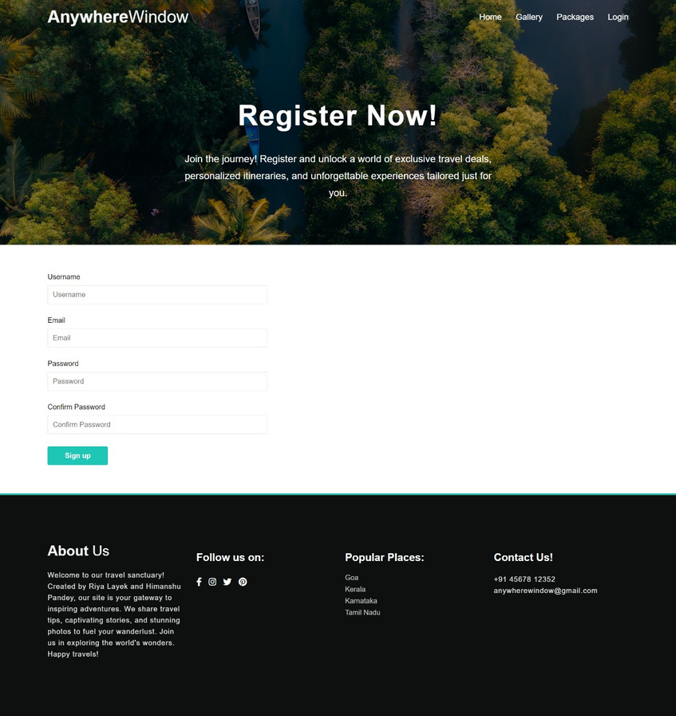
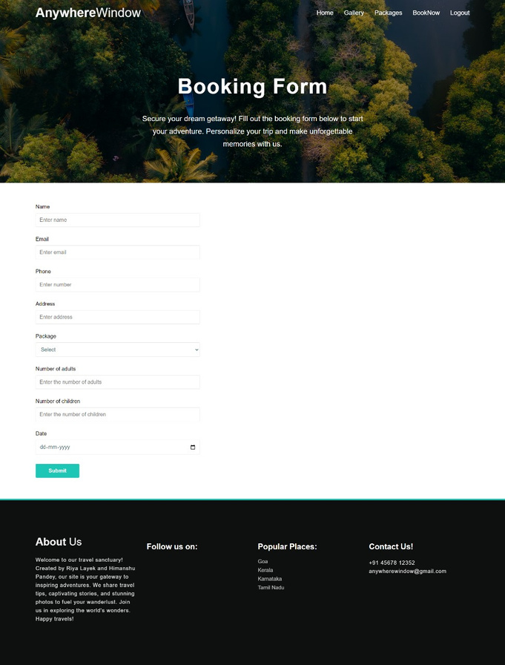
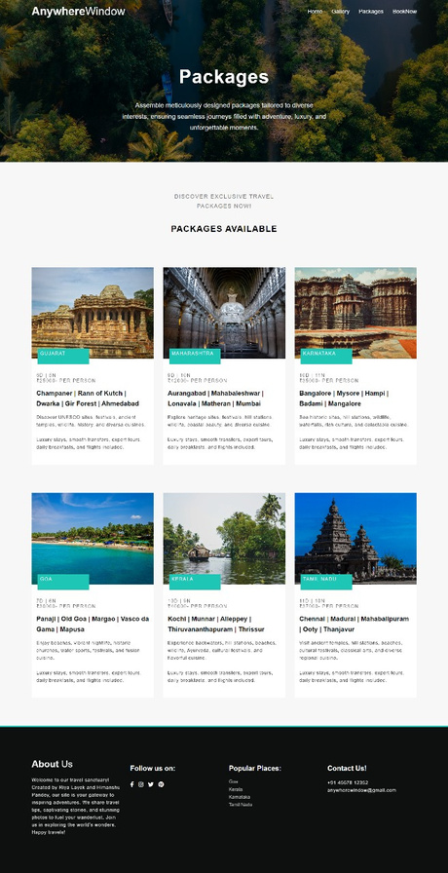
Website Page
Website page
Add a subheading

Slide 6
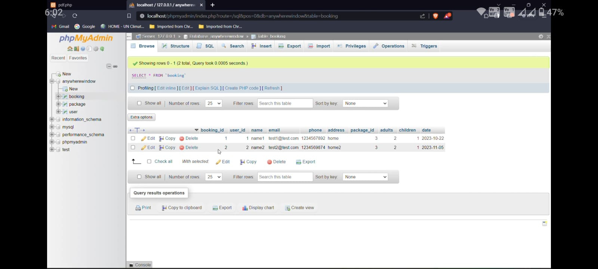
Database Design

Slide 7
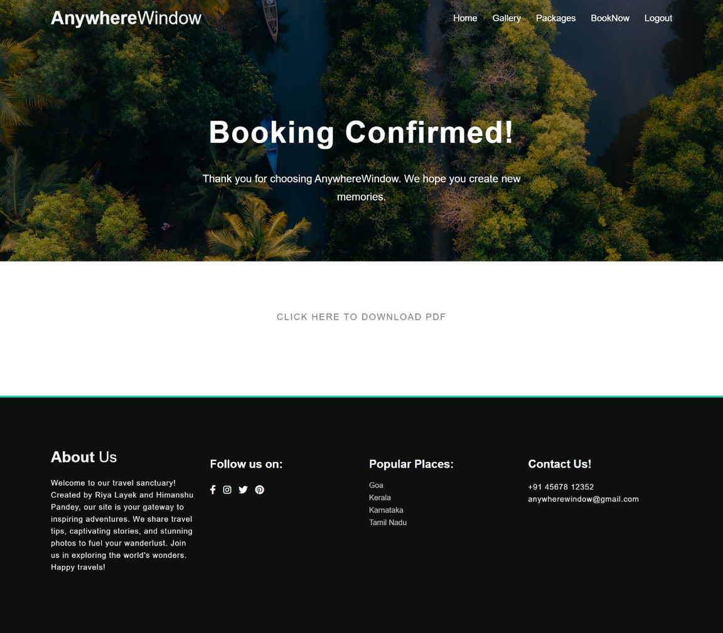
Conclusion
In this fast world, people are so busy with their
work and they don’t want to waste time book
tickets offline, which is very stressful and time-consuming and to overcome this platform we have
made a travel booking website.
Our travel booking website is very user-friendly and easy to use
it requires only information to book tickets from our website for travelling
And the best part is that our payment method that
you have to pay after completing your trip.

Slide 8
References
References
Githup.com
Youtube.com

